Slide 1
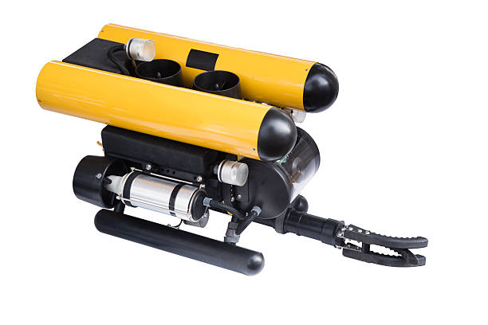
Remotely Operated Vehicle (ROV)
Al Saiaari Mohammed Nasser Saeed
1734429

Slide 2
01
INTRODUCTION

Slide 3
Remotely Operated Vehicle
A remotely operated vehicle (ROV) is an underwater robot that can be commanded from the surface by a human operator. ROVs are generally employed for ocean floor exploration, underwater maintenance and repairs, and scientific study.ROVs are tethered to a surface control center, which delivers power, control signals, and video feed back to the operator. The operator may navigate the ROV, operate its manipulator arms, and control its many sensors and cameras using joysticks and other controls.
ROVs range in size and configuration, from small, handheld devices to massive, deep-sea vehicles capable of operating at depths of several thousand meters. Some ROVs are also outfitted with sophisticated sensors and sampling tools that allow them to collect samples and data from the ocean below.ROVs have transformed our understanding of the ocean and allowed scientists and engineers to explore previously inaccessible locations. They're utilized for everything from oil and gas development to marine biological studies to search and rescue activities.

Slide 4
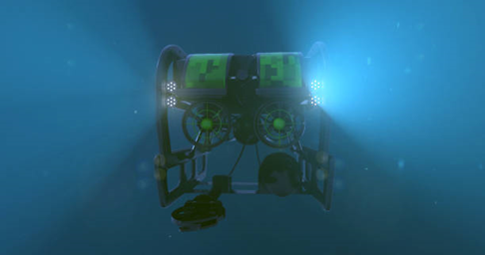
Applications
Its responsibilities range from basic examination of subsea infrastructure, pipes, and platforms to joining pipelines and installing undersea manifolds. They are widely employed in both the original construction of a subsea development and later repair and maintenance.
Marine Science and Oceanography
Search and Rescue
Commercial Diving and Salvage
Inshore Infrastructure
Offshore Energy

Slide 5
02
Main Components

Slide 6
Main Components
ROVs (remotely operated vehicles) are underwater robots that are used for a variety of applications including ocean exploration, scientific study, oil and gas exploration, and offshore construction. ROVs' primary components are:
Hull Design
Propulsion System
Navigation System & Control
Data Collection
Data Transmission
Power Management

Slide 7
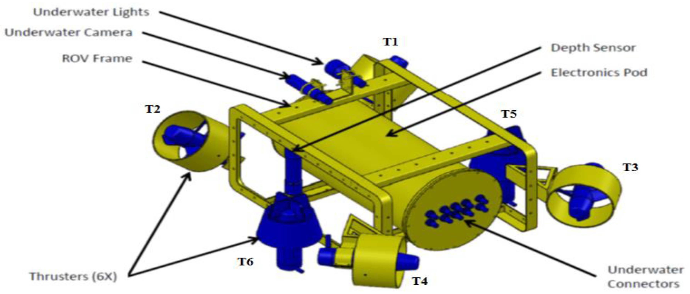
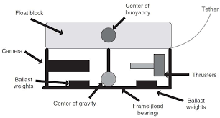
Hull Design
Frame and buoyancy: The frame provides a sturdy platform for the ROV's equipment and components, while the buoyancy system maintains the ROV's stability and depth.

Slide 8
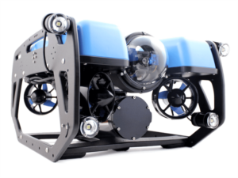
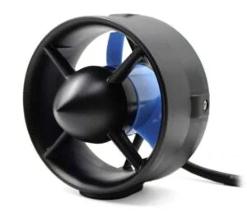
Propulsion System
ROVs often include thrusters that allow them to move forward, backward, up, and down in the water. The number and kind of thrusters might differ based on the size, weight, and intended function of the ROV.

Slide 9
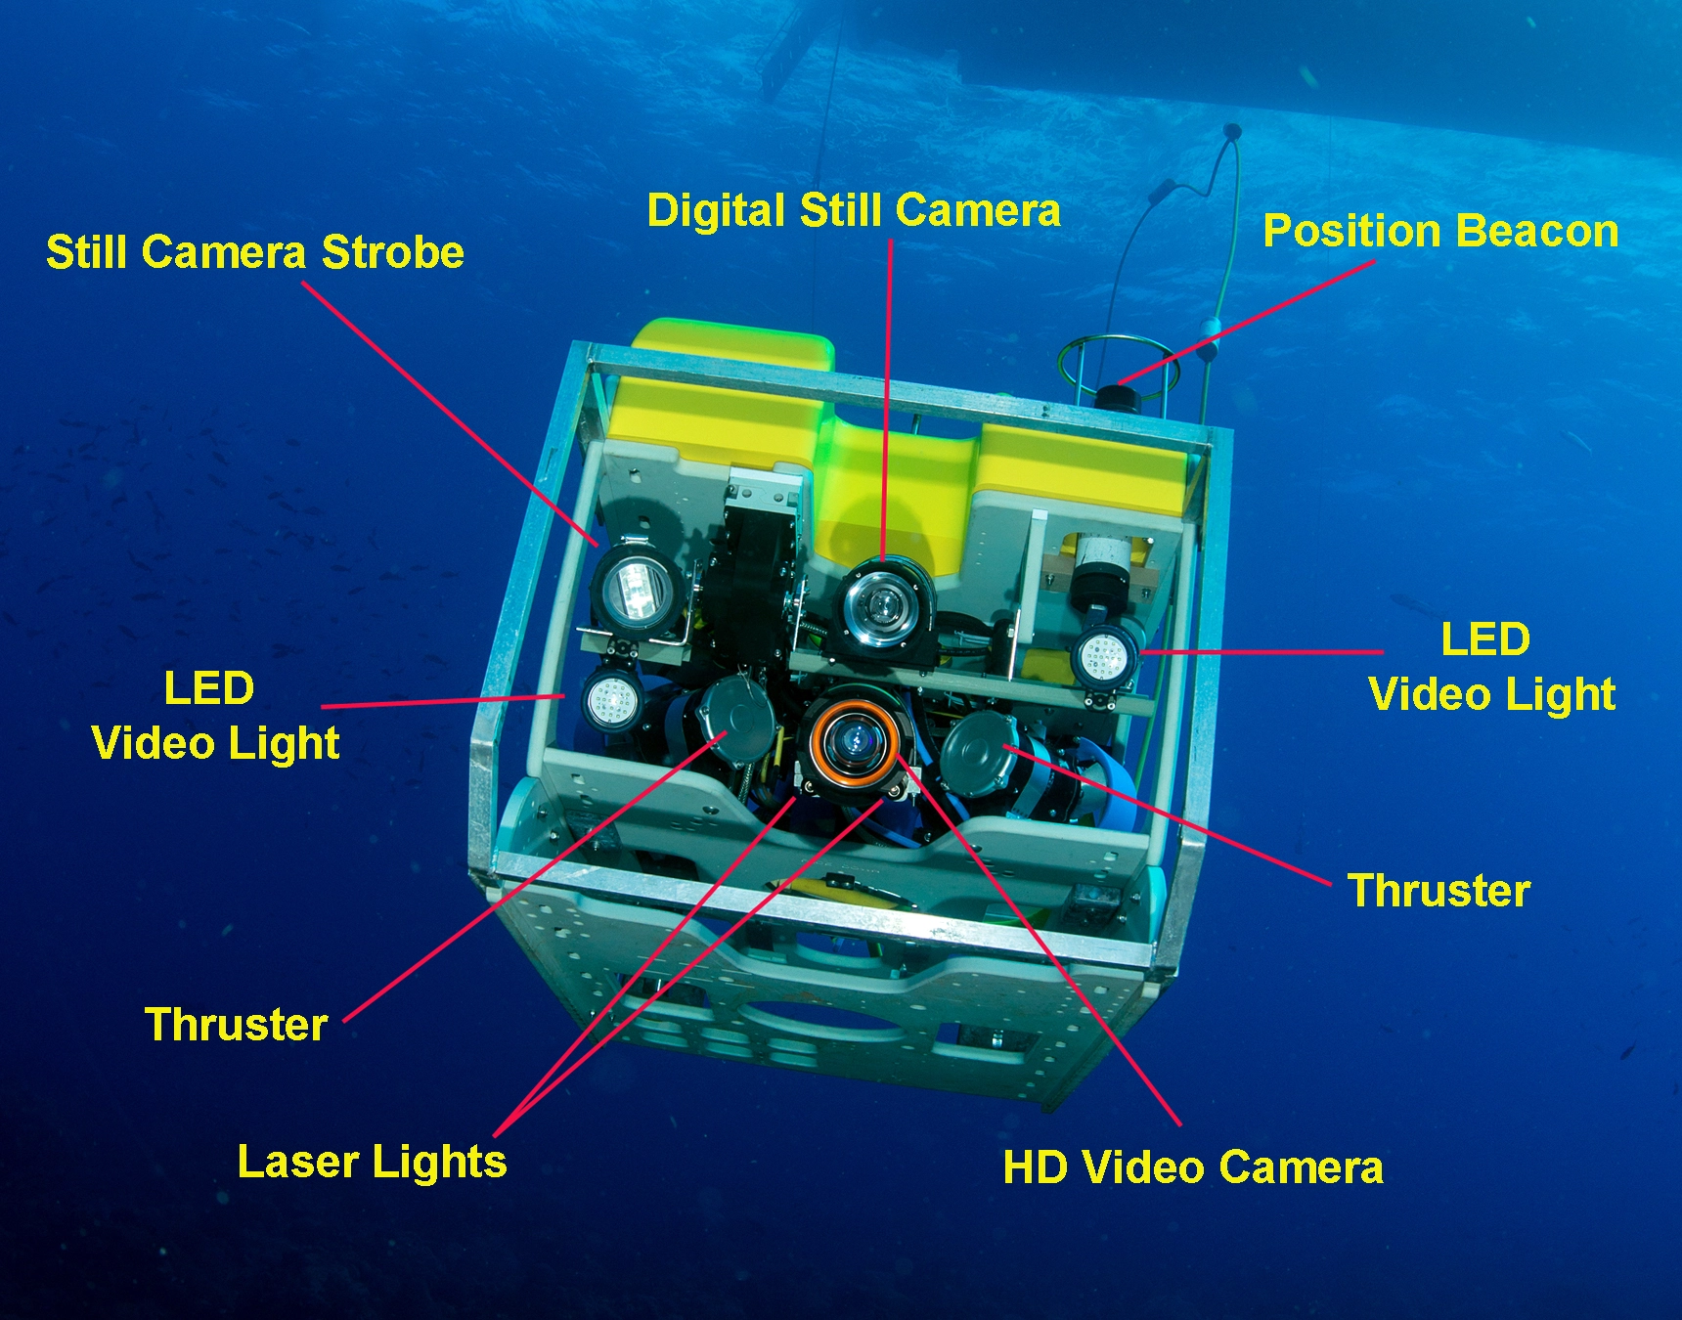
Navigation System
Positioning System: The ROV needs a precise positioning system to be able to locate itself underwater. Acoustic positioning systems, which employ sound waves to pinpoint the ROV's location in relation to a group of beacons positioned on the bottom, are the most prevalent positioning systems used in ROVs. Gyrocompass: To establish their direction and heading, ROVs also feature a gyrocompass. This makes it easier to make sure the ROV retains its planned heading and goes in the appropriate direction. Depth sensor: The ROV needs a depth sensor to gauge its underwater depth. For the ROV to remain at the correct height and depth, this information is crucial.

Slide 10
Control
Thrusters: Several thrusters on ROVs are used to steer the vehicles as they travel underwater. The ROV's movement may be precisely controlled in any direction thanks to the independent operation of these thrusters. Manipulators: ROVs frequently have manipulators, which enable them to carry out a variety of activities underwater. The ROV operator can remotely control these manipulators.High-definition cameras are installed aboard ROVs, and these cameras give a live video feed to the operator. As a result, the operator can observe what the ROV is observing and adjust the ROV's movement as necessary. Tether: ROVs are powered and communicated with via a tether that connects them to the surface. The ROV can be rapidly retrieved by the operator thanks to the tether, which also acts as a safety element.

Slide 11
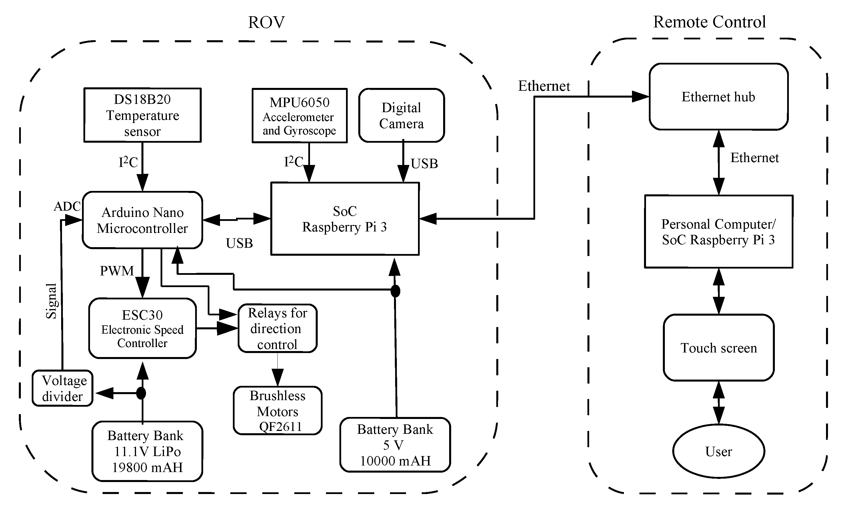
Data Collection
Typically, when collecting data with a ROV, sensors and cameras attached on the machine are used to measure underwater environmental factors including temperature, pressure, salinity, and water currents. By collecting pictures and films of underwater landmarks, creatures, and plant life, ROVs may also gather visual data.In order to control the ROV and the sensors and cameras on board, operators often utilize specific software and equipment while collecting data using ROVs. Researchers and scientists can then transfer the data that ROVs have obtained back to the surface for analysis.

Slide 12
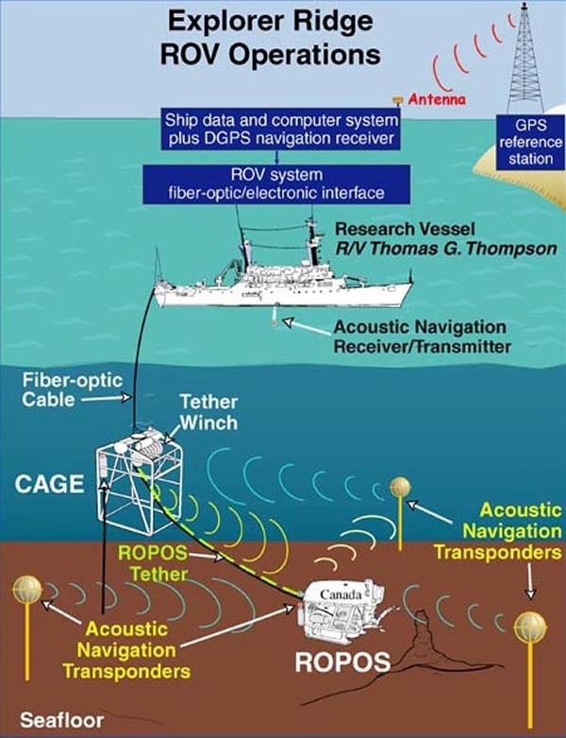
Data Transmission
Data transmission for ROVs may be done in a number of ways, including cable and wireless transmission.Data from the ROV to the operator is transmitted through wires during wired transmission. Since the distance between the ROV and the operator is not too considerable, this approach is frequently utilized in shallow water operations. As data is delivered instantaneously across the cable, wired transmission provides a high level of data dependability and real-time feedback.On the other side, wireless communication uses acoustic or radio waves to send data from the ROV to the operator. This technique is frequently utilized in deep-water operations where there is a large physical separation between the ROV and the operator. The benefit of wireless communication is that it eliminates the need for physical wires and enables remote operation of the ROV from a secure place.

Slide 13
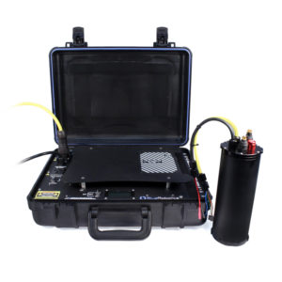
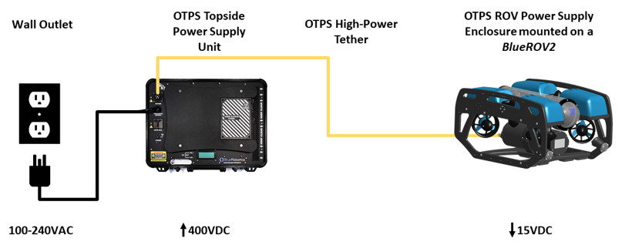
Power Management
A power distribution system, a battery system, and a charging system are the usual components of a ROV's power management system. The power distribution system makes ensuring that electricity is routed safely and effectively to the several pieces of equipment aboard the ROV. The ROV is powered by a battery system, and when the batteries run out of power, a charging mechanism restores its power. The low battery capacity is one of the main issues with ROV power management. Because ROVs work in a dangerous underwater environment, they require powerful batteries with a lengthy shelf life. An ROV's battery capacity is restricted, therefore operators must carefully control power usage to make sure the ROV can finish its task and safely return to the surface.

